Slide 1
Health Protection Surveillance Centre
Surveillance of outbreaks of infectious disease in Ireland:
Q1 2019 provisional data
July, 2019

Slide 2
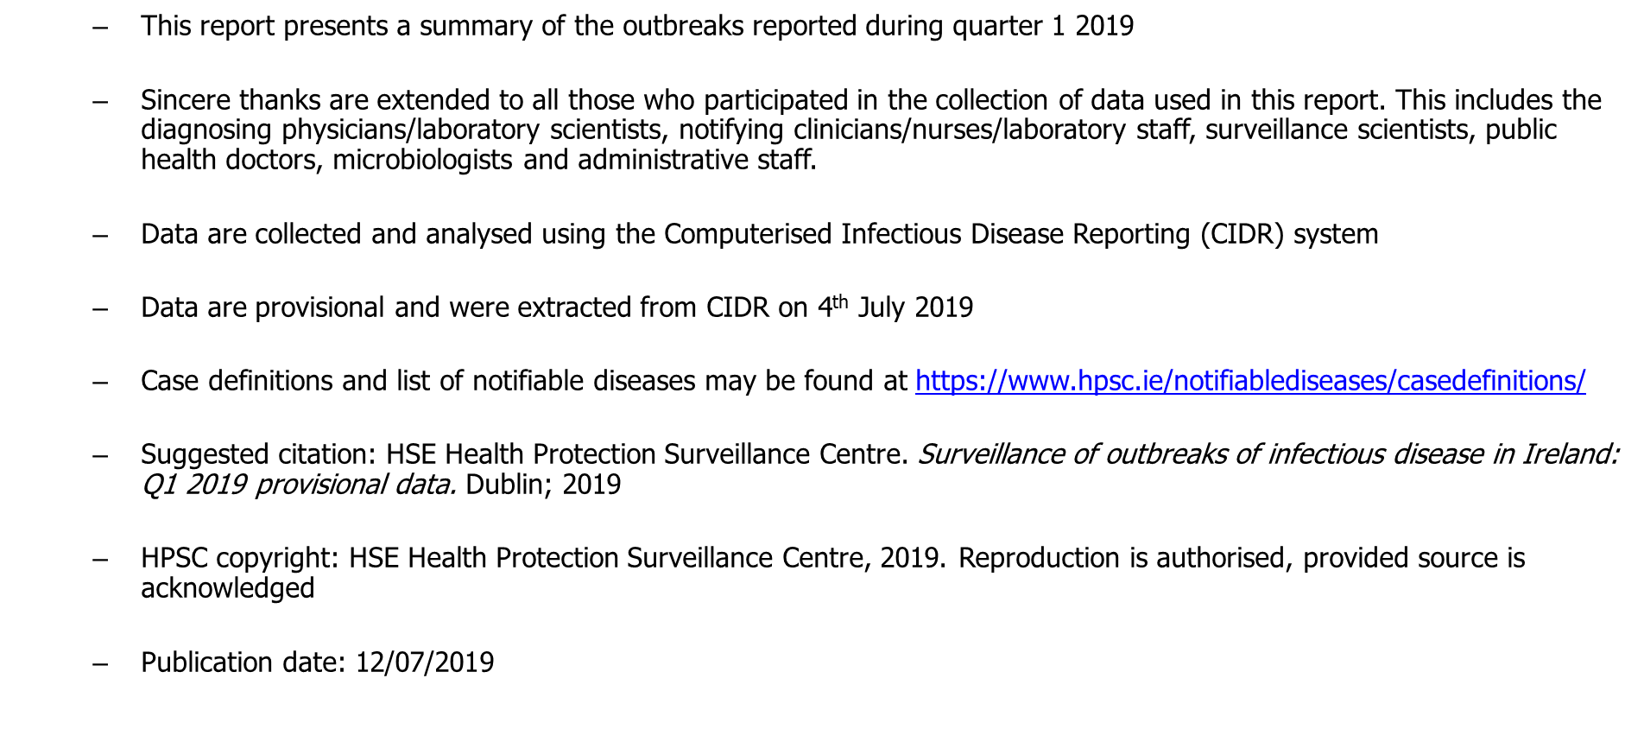
Provisional data, Q1 2019

Slide 3
Key Points – Q1 2019

Slide 4
Outbreaks of infectious disease in Ireland, Q1 2019

Slide 5
Outbreaks of infectious disease in Ireland, Q1 2019

Slide 6
Outbreaks of infectious disease in Ireland, Q1 2019

Slide 7
Outbreaks of infectious disease in Ireland, Q1 2019

Slide 8
Outbreaks of infectious disease in Ireland, Q1 2019

Slide 9
Further Information
Further information on outbreaks can be found at
https://www.hpsc.ie/a-z/outbreaks/

